Slide 1
Out Of Time: The Game
B00349622 – Kieran Lewis
B00349036 – Steven Benson
B00357866 – Angelika Kolodziej

Slide 2
Game idea & Overview
Out of Time is a Time Travelling 2D Side Scrolling Shooter
The game takes place in many different settings from Ancient Egypt all the way to the future of 2084
We thought a time travelling game would be fun as nowadays it’s quite rare.
We wanted a wacky style of time travel not a chronological order or a specific the character knows where he’s going

Slide 3
Game IDEA AND OVERVIEW CONTINUED
We wanted full control of the implementation, we wanted Health pickups, ammo pickups and new weapons for the player to use.
We wanted a boss at the end of the game who was behind everything but this had to be scrapped in the prototype

Slide 4
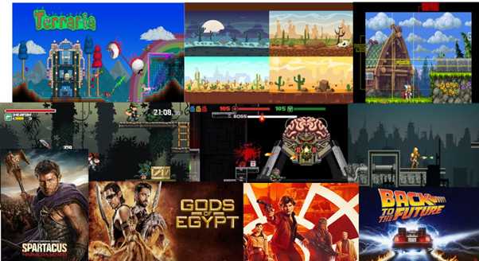
Inspiration
The game was heavily inspired from the Time Splitters series with some inspiration from films like Back to the Future, Bill and Ted’s Excellent Adventure and the tv show Doctor Who.

Slide 5
Game Engine Choice
We chose Unity 2017.3.1f1 because Kieran was most experienced in it compared to Unreal Engine 4.
It has worked in the past for many projects
Steven has good experience in Unreal Engine however he wanted to use Unity to build his skills in it again
It is easy to use and very user friendly
We didn’t use Unreal Engine because we haven’t ever made a 2D game in it

Slide 6
Gameplay and Mechanics
The game plays like a 2D Shooter.
The player moves along a linear path throughout each level and kills each enemy to get by them
Included a gun switching mechanic to spice up the game allowing multiple ways to defeat various enemies. Each gun performs differently from each other
We wanted the game to feel quite fast however the game was slower paced at first

Slide 7
Gameplay and mechanics continued
Various enemies in the game that act differently. If certain enemies are hit too much then they will be slower
There are platforms that can move and add a new sense of playability to the game.

Slide 8
Team Roles
Angelika joined the group on Week 3 which meant our work load could increase and it also meant that the workload was more evenly spread.
Before this Kieran was Lead Programmer and Steven was Lead Artist.
Angelika became a team artist with Steven as she was good at art.

Slide 9
Level Design
We wanted each level to feel different but to still be similar to the overall gameplay loop

Slide 10
Game Implementation

Slide 11
Immersive Qualities

Slide 12
Version Control

Slide 13
Out of Time: Prototype Demo

Slide 14
Individual Contribution
Angelika took care mostly of the characters. The way they look, the animations. She also has done backgrounds to each levels.

Slide 15
Learning experience as a team
It was the first time Angelika needed to create Game Design Document so both Kieran and Steven needed to guide her through it.

